Slide 1
Unit 202: Principles of electrical science
Electro-magnetism

Slide 2
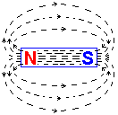
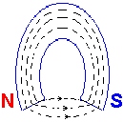
Electro-magnetism
Magnetic field
Lines of flux cannot cross Lines of flux flow externally from the North Pole to the South Pole.

Slide 3
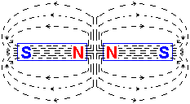
Electro-magnetism
Magnetic field
Two permanent magnets – North Pole to North Pole
Like poles repel

Slide 4
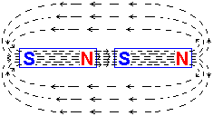
Electro-magnetism
Magnetic field
Two permanent magnets – North Pole to South Pole
Unlike poles attract

Slide 5

Electro-magnetism
Current direction convention
Current flowing into the conductor (ie away from the observer)
Current flowing out of the conductor (ie towards the observer)

Slide 6
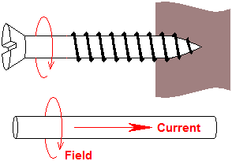
Electro-magnetism
Maxwell’s screw rule

Slide 7




Electro-magnetism
Magnetic fields due to electric current
In straight conductors
In a flat coil

Slide 8
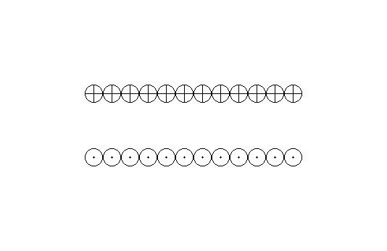
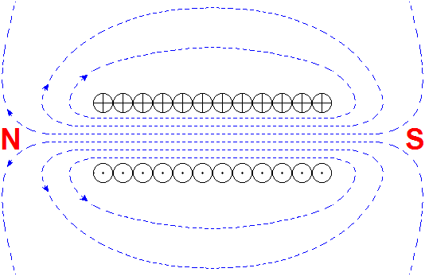
Electro-magnetism
Magnetic fields due to electric current
In a solenoid

Slide 9
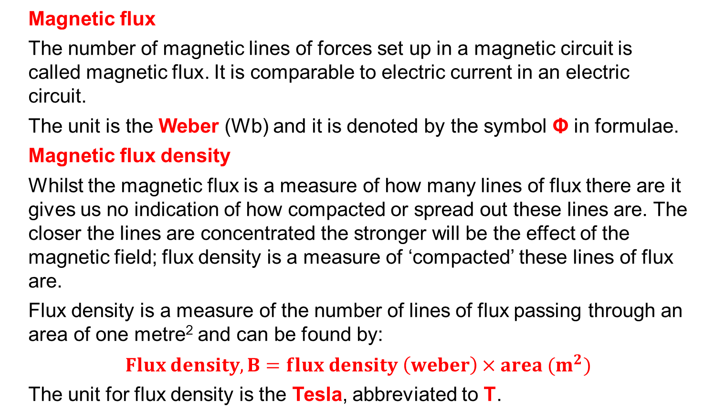
Electro-magnetism
Magnetic flux
The number of magnetic lines of forces set up in a magnetic circuit is called magnetic flux. It is comparable to electric current in an electric circuit.
The unit is the Weber (Wb) and it is denoted by the symbol Φ in formulae.
Magnetic flux density
Whilst the magnetic flux is a measure of how many lines of flux there are it gives us no indication of how compacted or spread out these lines are. The closer the lines are concentrated the stronger will be the effect of the magnetic field; flux density is a measure of ‘compacted’ these lines of flux are.
Flux density is a measure of the number of lines of flux passing through an area of one metre² and can be found by:
$$Flux density, B=flux density \left(weber\right)×area (m^{2})$$
The unit for flux density is the Tesla, abbreviated to T.

Slide 10
Unit 202: Principles of electrical science
The End

